Slide 1
Red Black Tree
Dr. Naveen Kumar
Associate Professor
Amity Institute of Information Technology
Amity University Patna

Slide 2
A red-black tree is a binary search tree (BST) with one extra attribute for each node: the colour. Which is either red or black.

Slide 3
Red Black Tree Properties
A red-black tree is a binary search tree which has the following red-black properties:
Every node is either red or black.
Every leaf (NULL) is black.
If a node is red, then both its children are black.
Every simple path from a node to a descendant leaf contains the same number of black nodes.

Slide 4
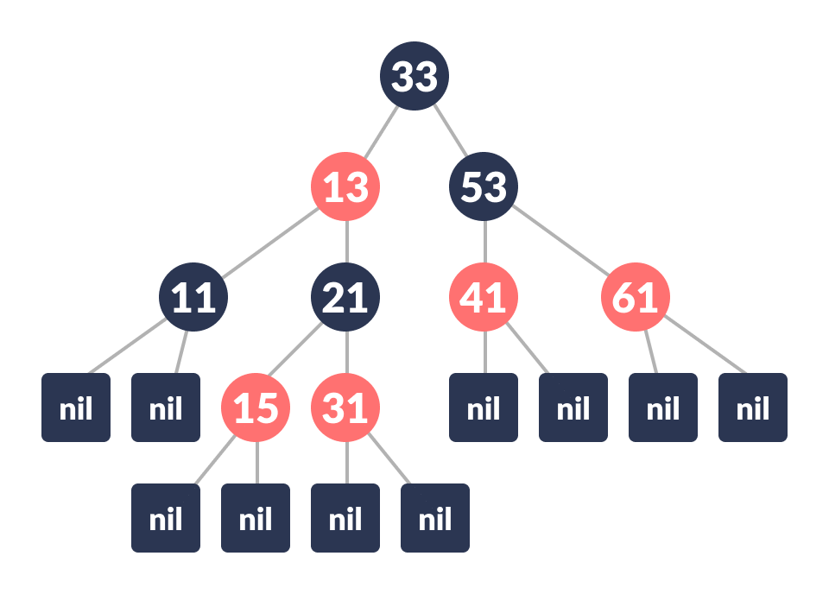
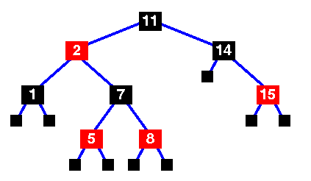

Slide 5
Each node has the following attributes:
color
data
leftChild
rightChild
parent (except root node)
The number of black nodes on any path from, but not including, a node x to a leaf is called the black-height of a node, denoted bh(x). We can prove the following lemma:

Slide 6
Inserting an element into a Red-Black Tree
The new node is always inserted as a RED node.
After insertion of a new node, if the tree is violating the properties of the red-black tree then, we do the following operations.
Recolor
Rotation

Slide 7
Algorithm to insert a node
Let y be the leaf (ie. NIL) and x be the root of the tree.
Check if the tree is empty (ie. whether x is NIL). If yes, insert newNode as a root node and color it black.
Else, repeat steps following steps until leaf (NIL) is reached.
Compare key with root.data.
If key is greater than root.data, traverse through the right subtree.
Else traverse through the left subtree.
Assign the parent of the leaf as a parent of newNode.
If leafKey is greater than key, make newNode as rightChild.
Else, make newNode as leftChild.
Assign NULL to the left and rightChild of newNode.
Assign RED color to newNode.
Call InsertFix-algorithm to maintain the property of red-black tree if violated.

